Slide 2
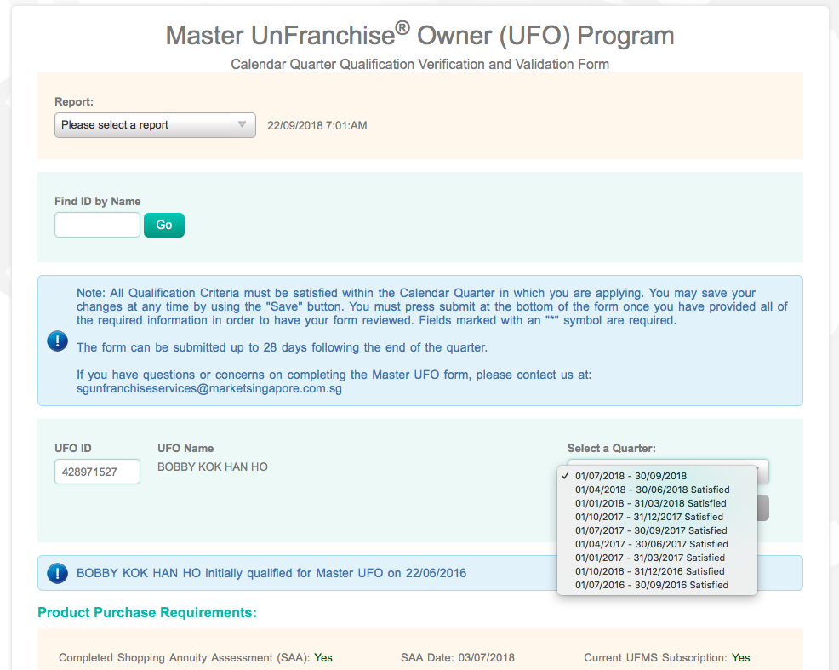
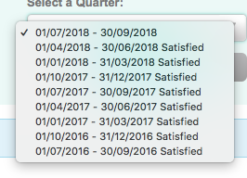

Slide 3
Mindset
Action
Notes:
Mindset & Action

Slide 4
ATTITUDE
Notes:
Attitude no subpoint translation

Slide 6
What should I do
Master UFO

Slide 7
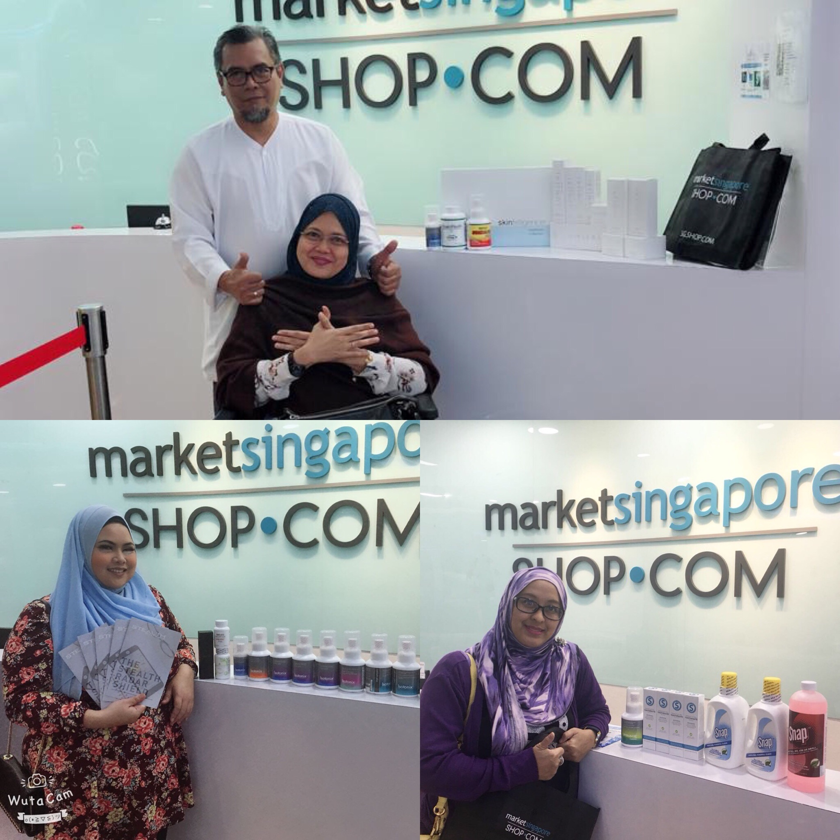
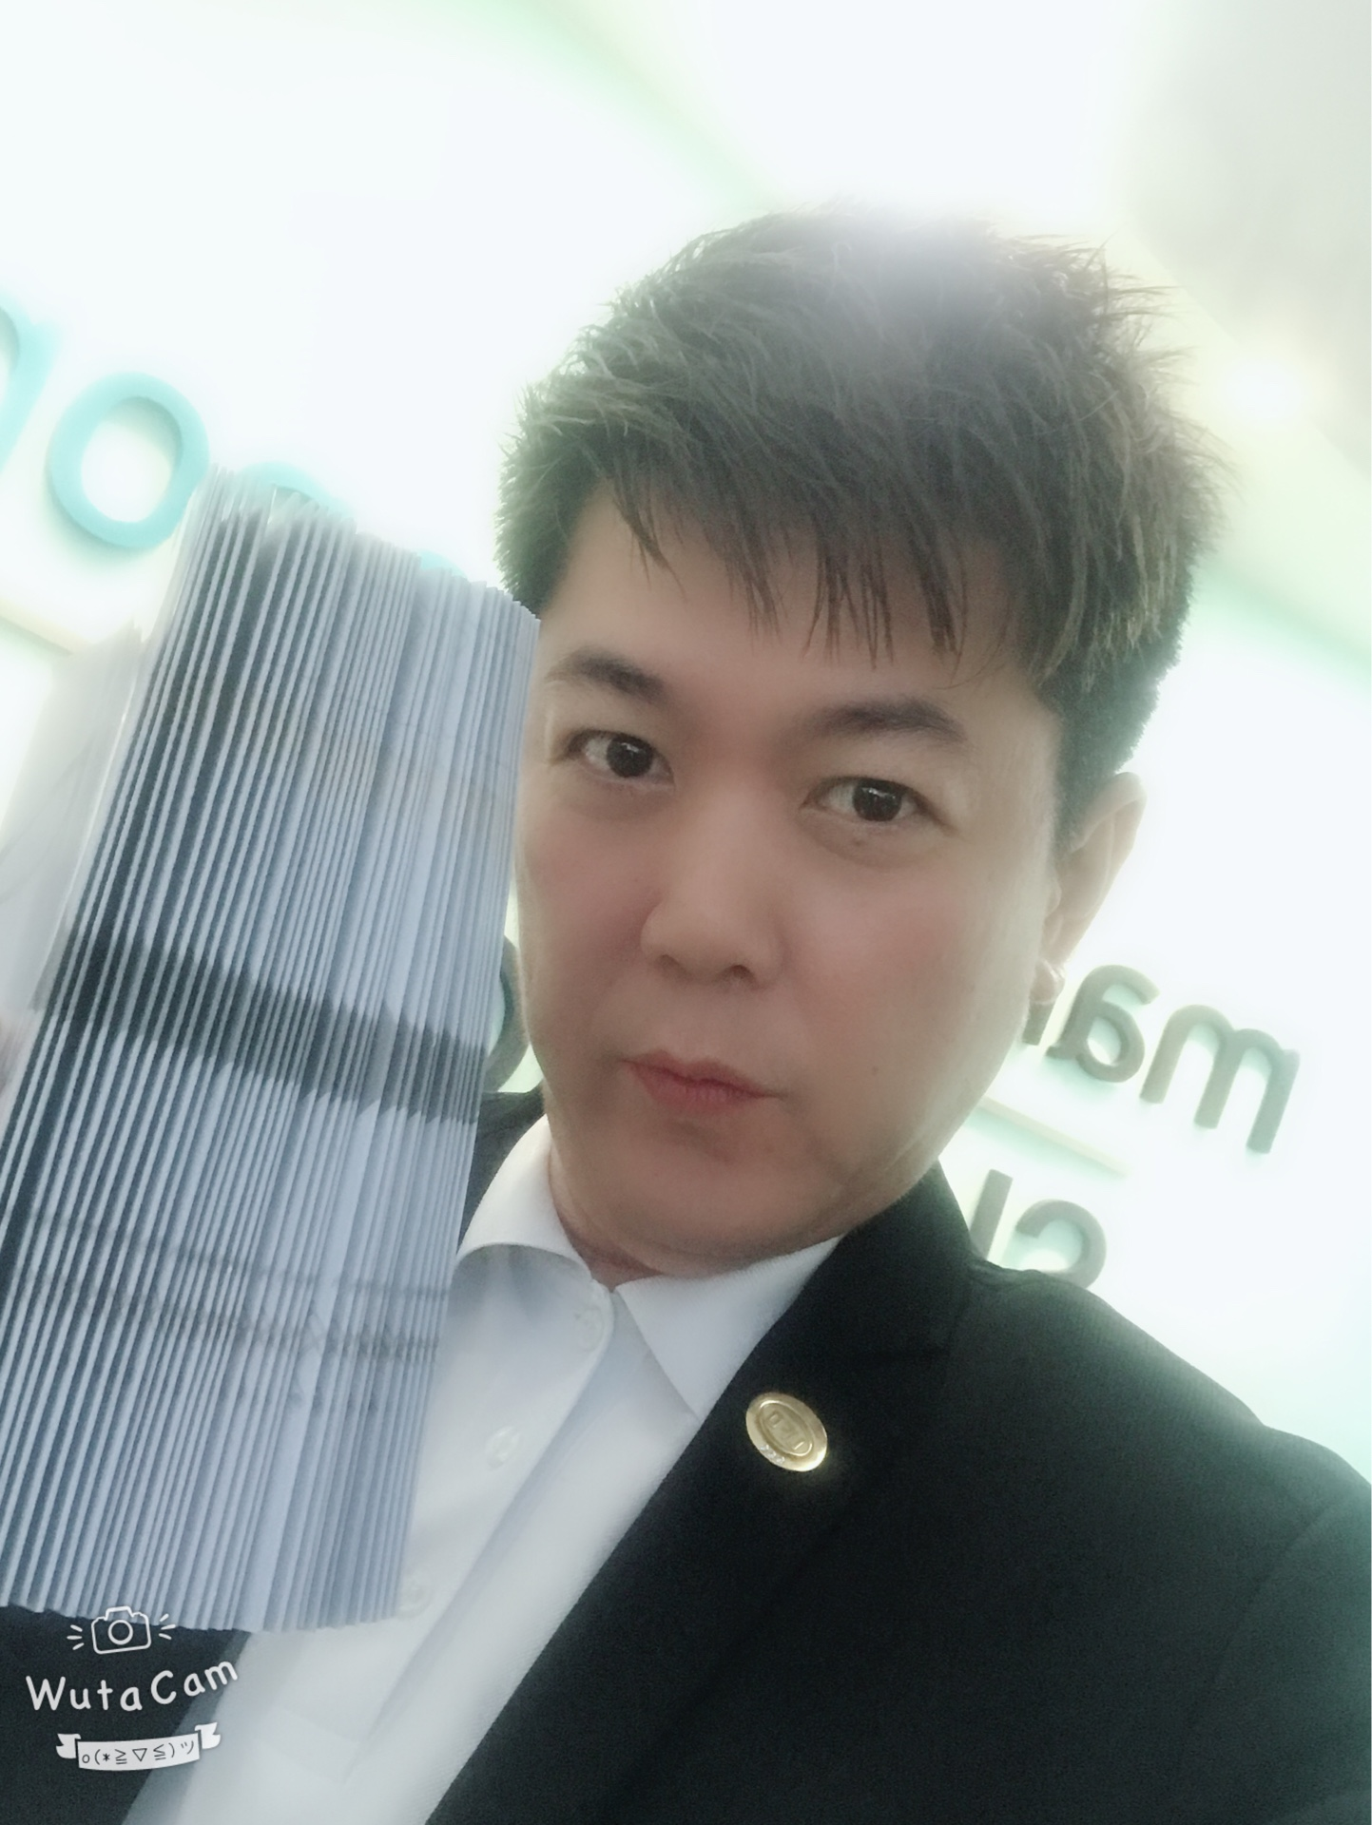
Sales Volume
1,500BV

Slide 8
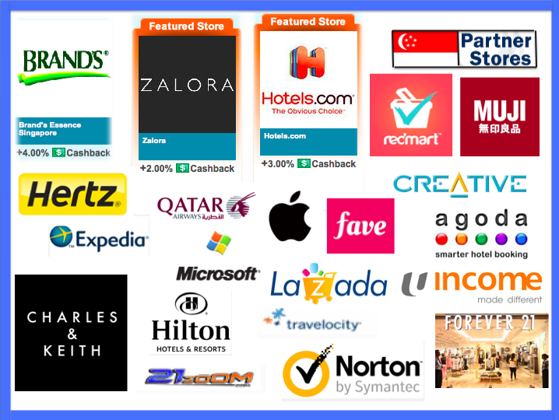
Partner Stores
A Quarter: S$1,875.00

Slide 9
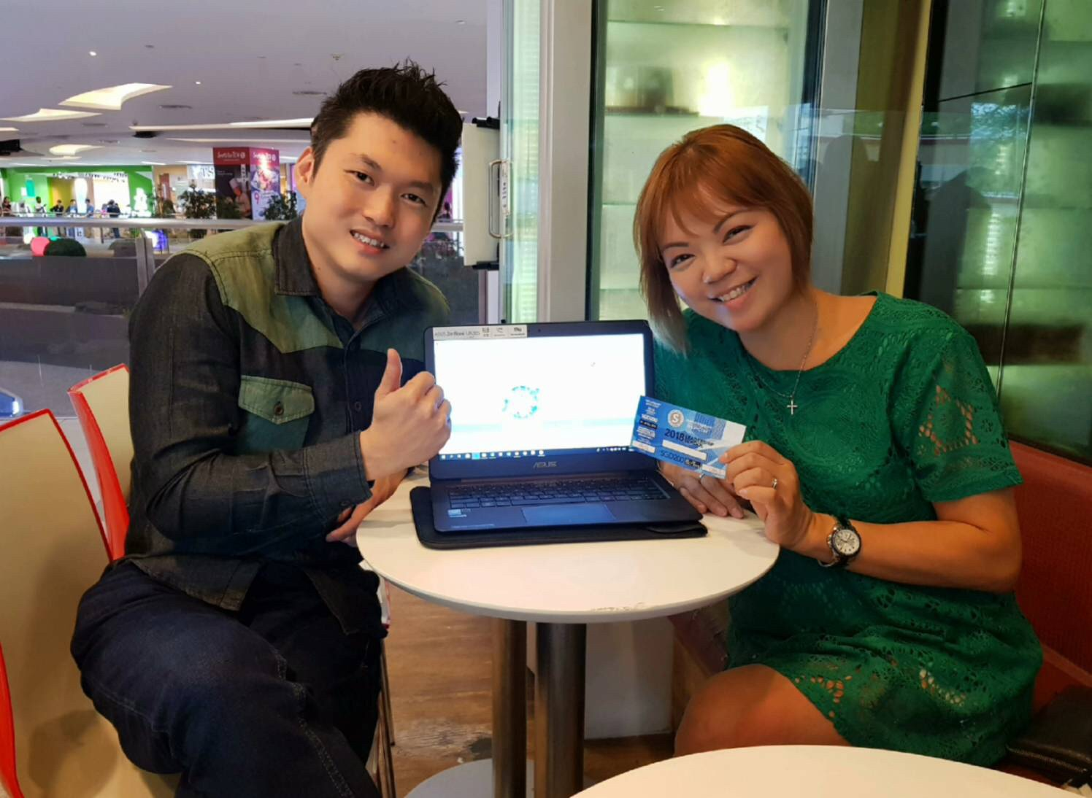
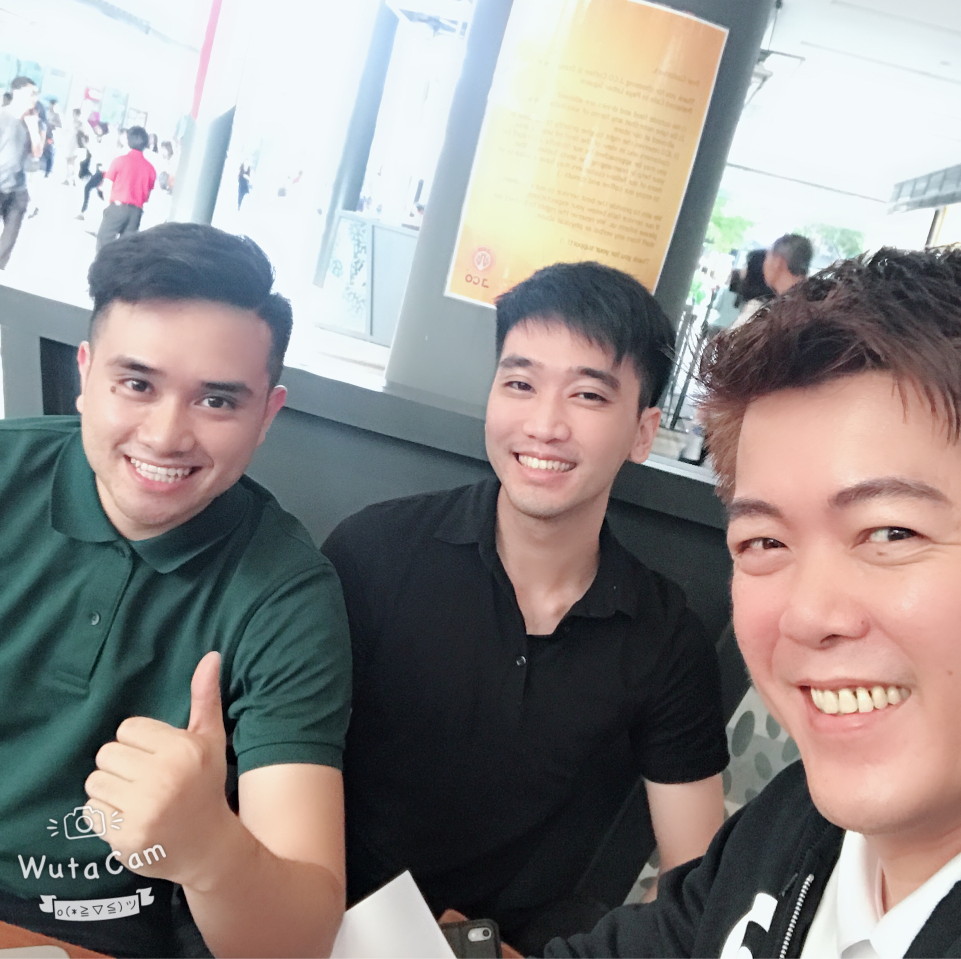
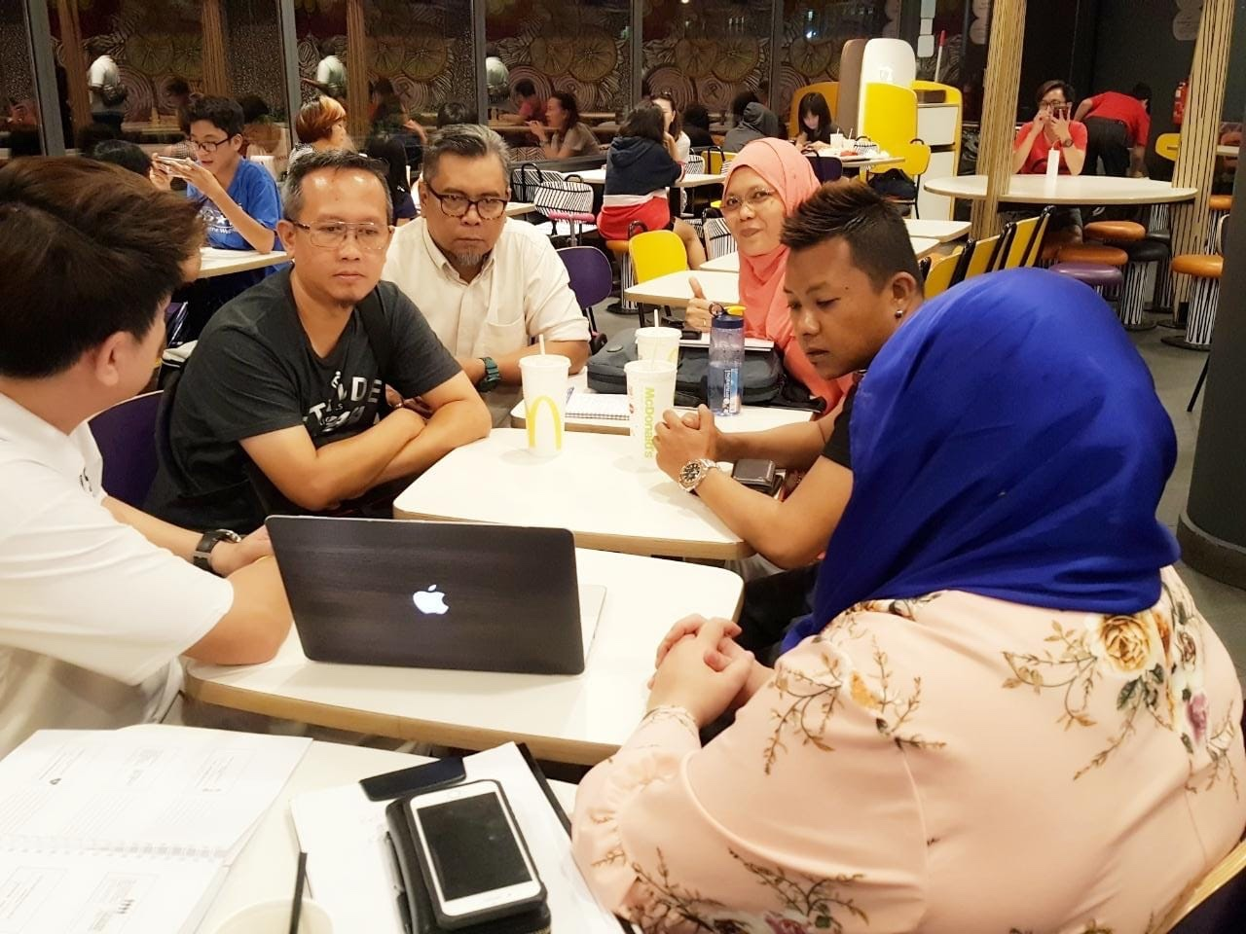
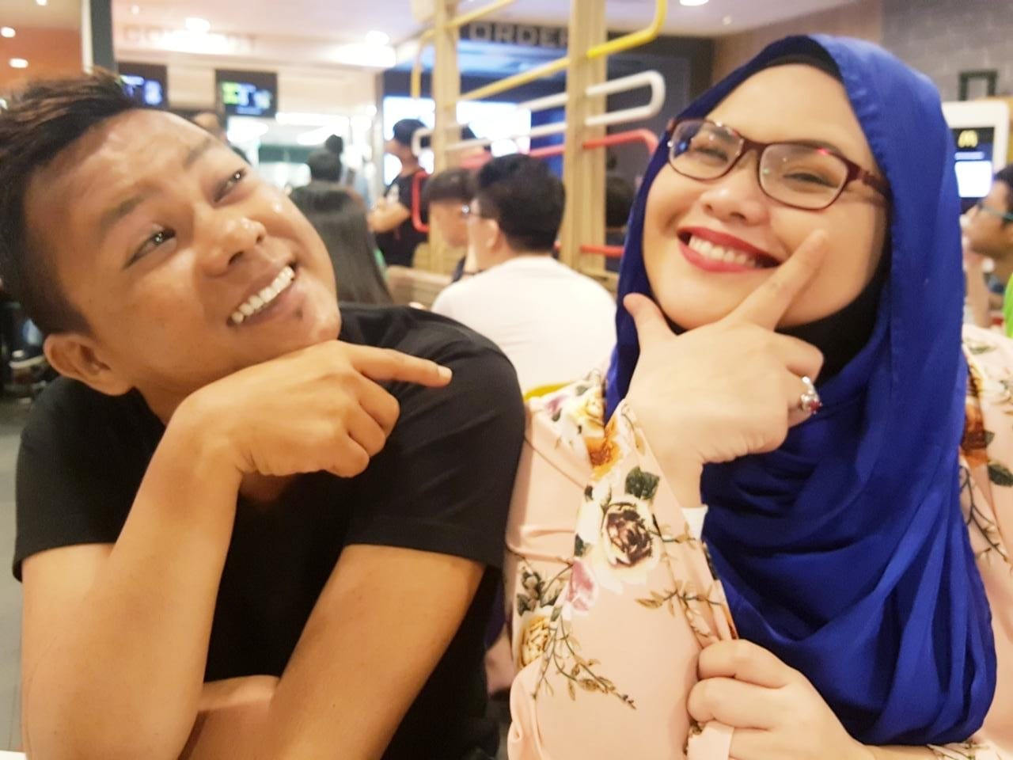
Recruiting

Slide 10
1 year
A
S$10,500 Month
B
2 year
A 1
A 2
B 1
C
3 year
A1
S$3,000 / Month
B 2
4 year
4
100BV / Month
4
5 year
8
25,600 BV / Month
8
25,600 BV / Month
6 year
16
16
7 year
32
32
8 year
64
6,400 BV / Week
6,400 BV / Week
64
9 year
128
128
S$7,500 / Month
10 year
256
256

Slide 11
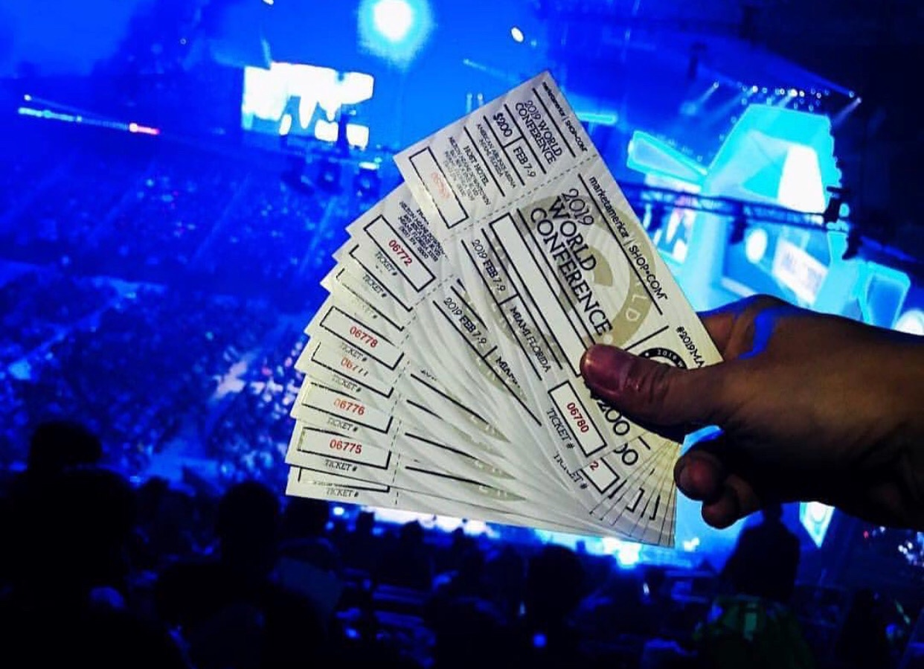
Convention Tickets

Slide 12
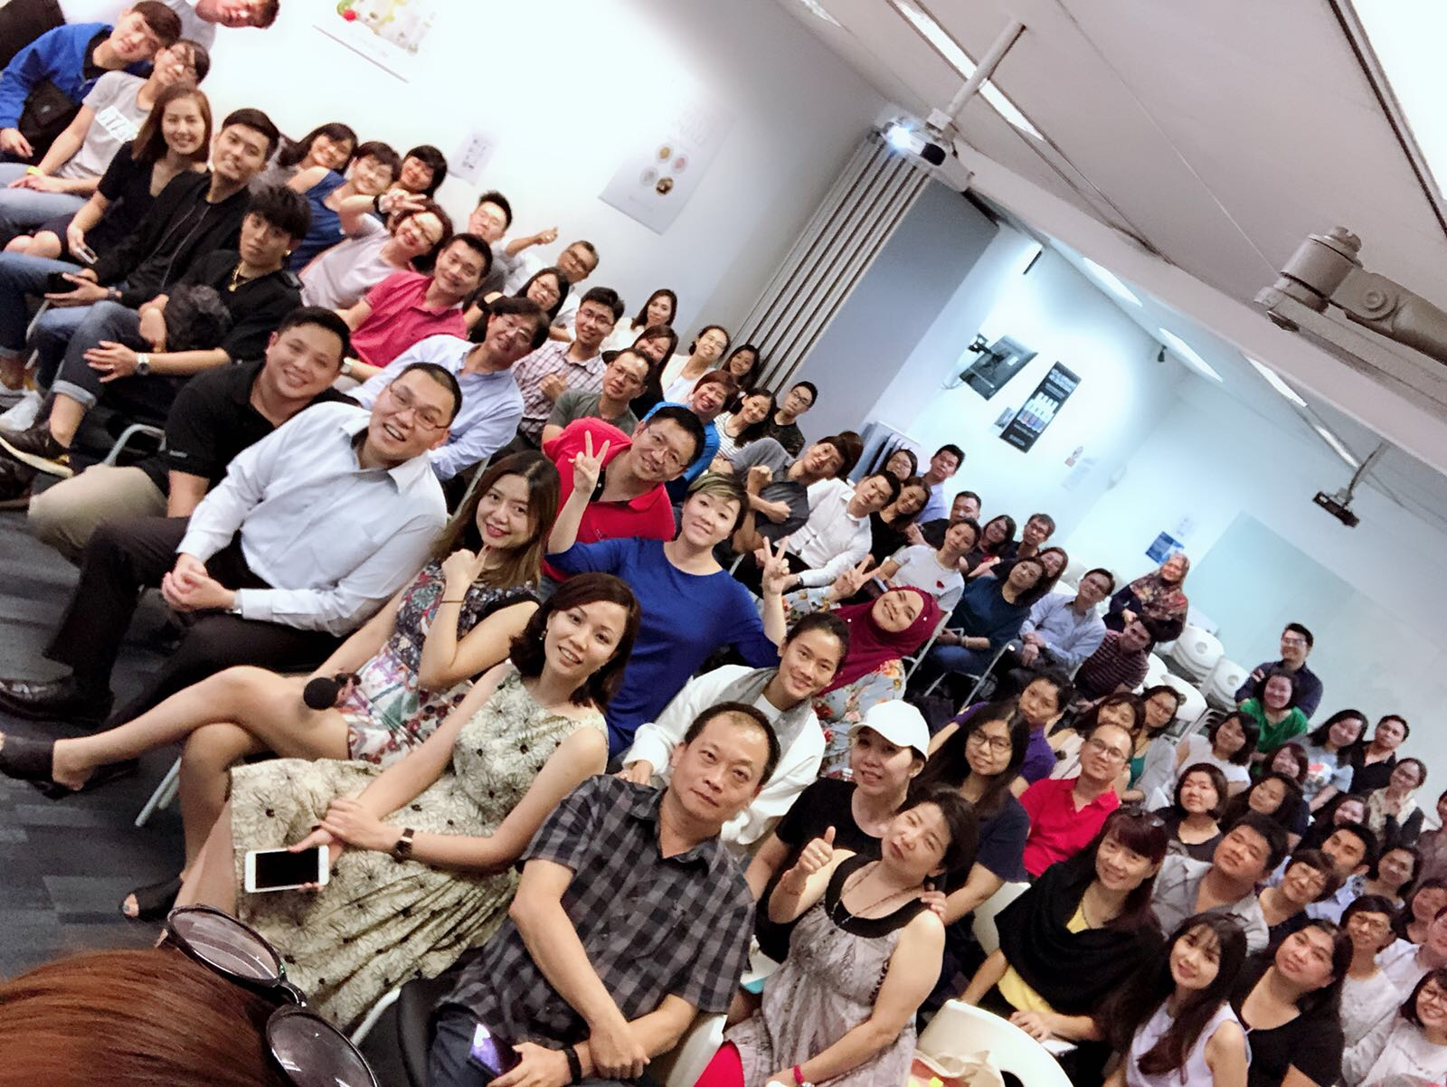
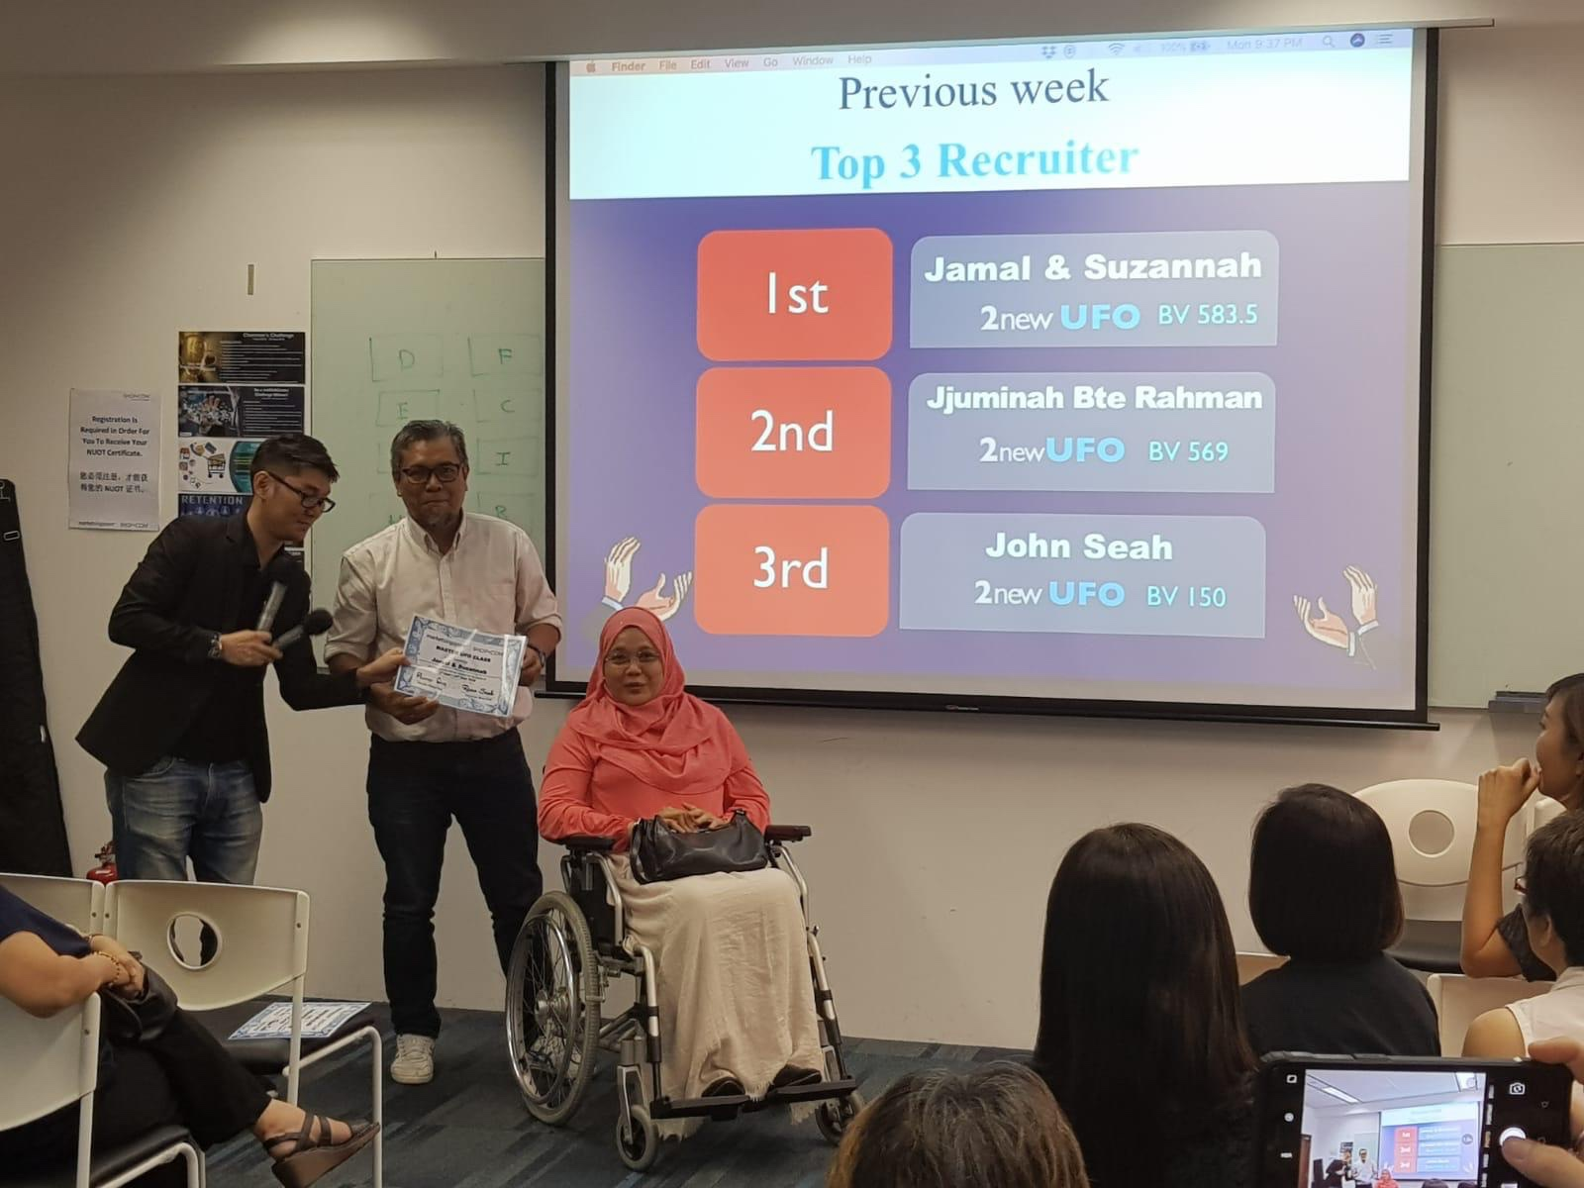
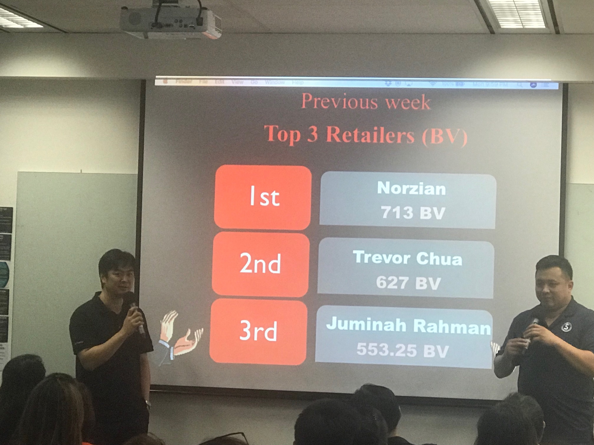
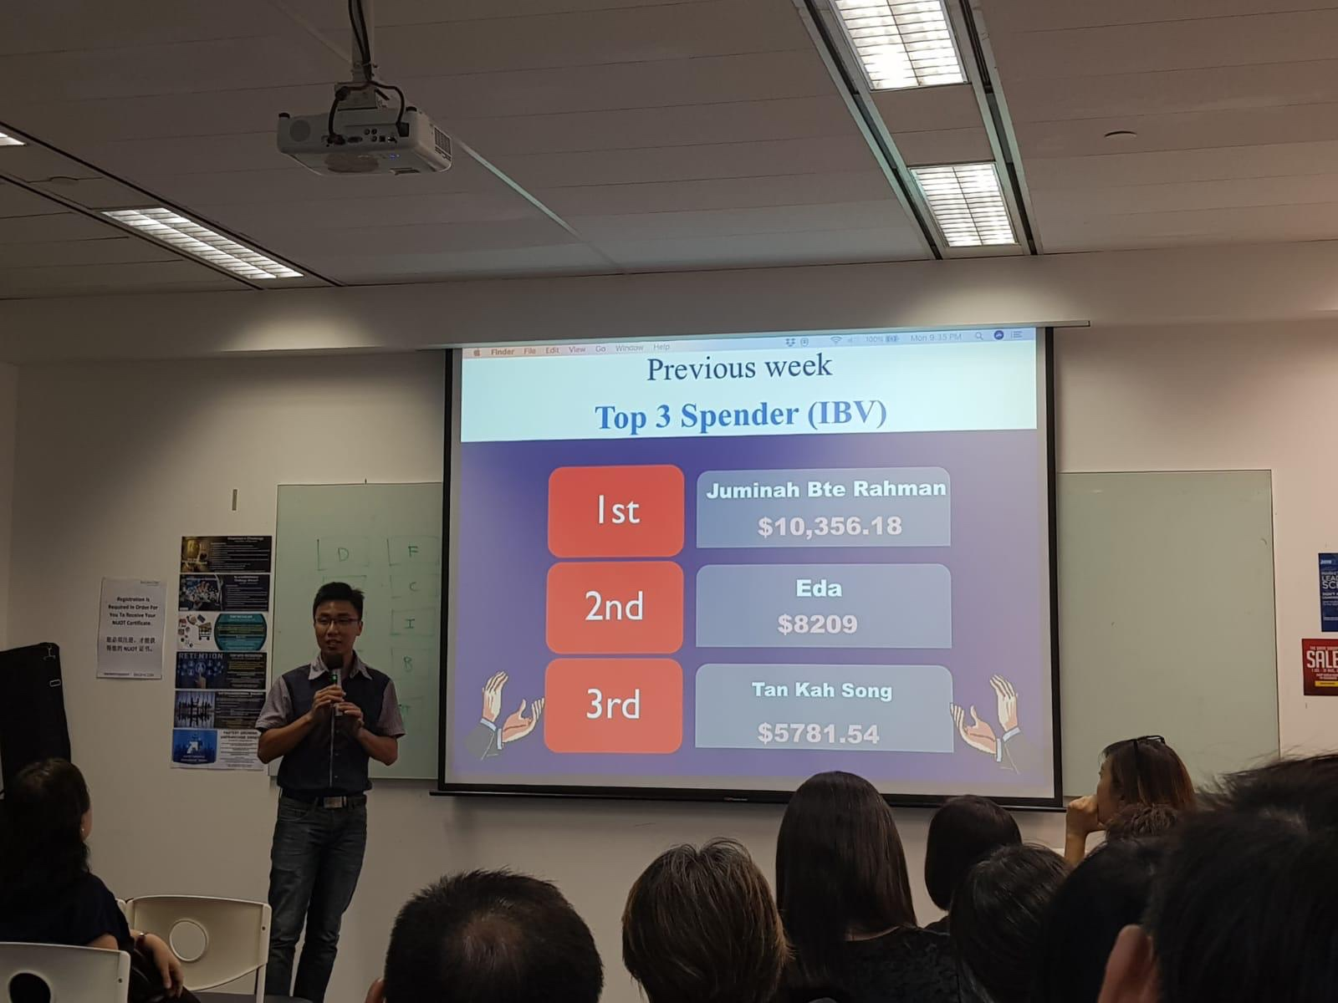
Master UFO
Class
10 session per quarter
Exclusive Products
1,134BV
Partner Stores
$10,356.18
Two New Partners

